Slide 1


Julio Ceballos
08/14/23

Slide 2

Outline
Executive Summary
Introduction
Methodology
Results
Conclusion
Appendix

Slide 3
Executive Summary
Summary of methodologies
Data Collection using web scraping and SpaceX API; • Exploratory Data Analysis (EDA), including data wrangling, data visualization and interactive visual analytics; • Machine Learning Prediction.
Summary of all results
All data collected came from public sources
EDA helped identify the features best ft to predict a successful landing
Machine Learning helped show which model to apply for the best possible success rate

Slide 4
Introduction
Project background and context
The project background was to simulate a real-world scenario as Coursera’s final capstone project for the Data Science Certificate
Problems you want to find answers
The best way to predict future successful landing of the stage 1 rocket that SpaceX’s Falcon 9 uses in scenarios involving locations

Slide 5

Section 1

Slide 6
Methodology
Executive Summary
Data collection methodology:
Data was collected using SpaceX REST API and Web scraping from Wikipedia
Perform data wrangling
Data was processed by implementing the one-hot encoding method for categorial features
Perform exploratory data analysis (EDA) using visualization and SQL
Perform interactive visual analytics using Folium and Plotly Dash
Perform predictive analysis using classification models
How to build, tune, evaluate classification models

Slide 7
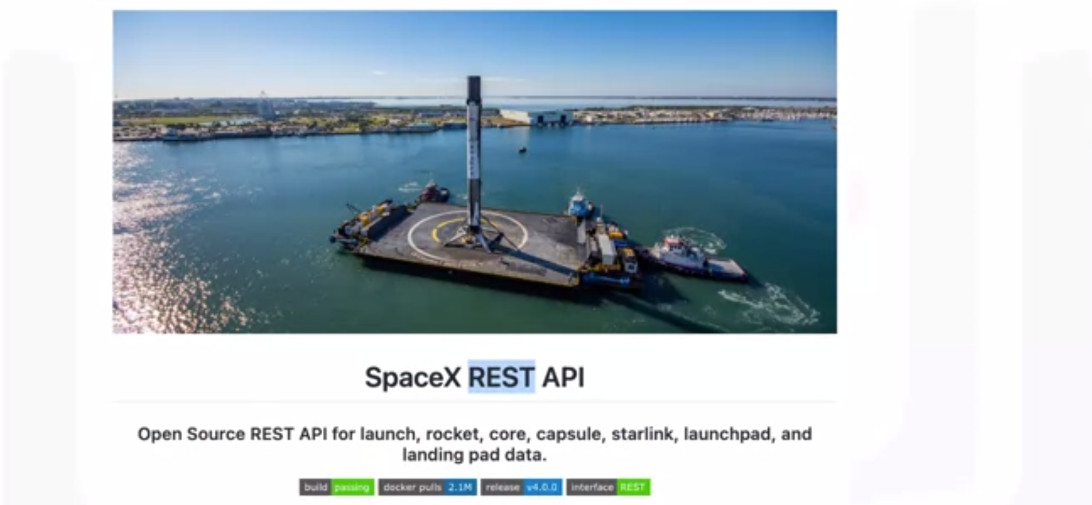
Data Collection
Describe how data sets were collected.
Data sets were collected from Space X API (https://api.spacexdata.com/v4/rockets/) and from Wikipedia (https://en.wikipedia.org/wiki/List_of_Falcon/_9/_and_Falcon_Heavy_launches), using web scraping technics.

Slide 8
Data Collection – SpaceX API
The SpaceX API is a public API where data from their missions can be used
https://github.com/OficialmenteJJC/Data-Science-Capstone/blob/main/Lab%201%20Capstone%20project

Slide 9
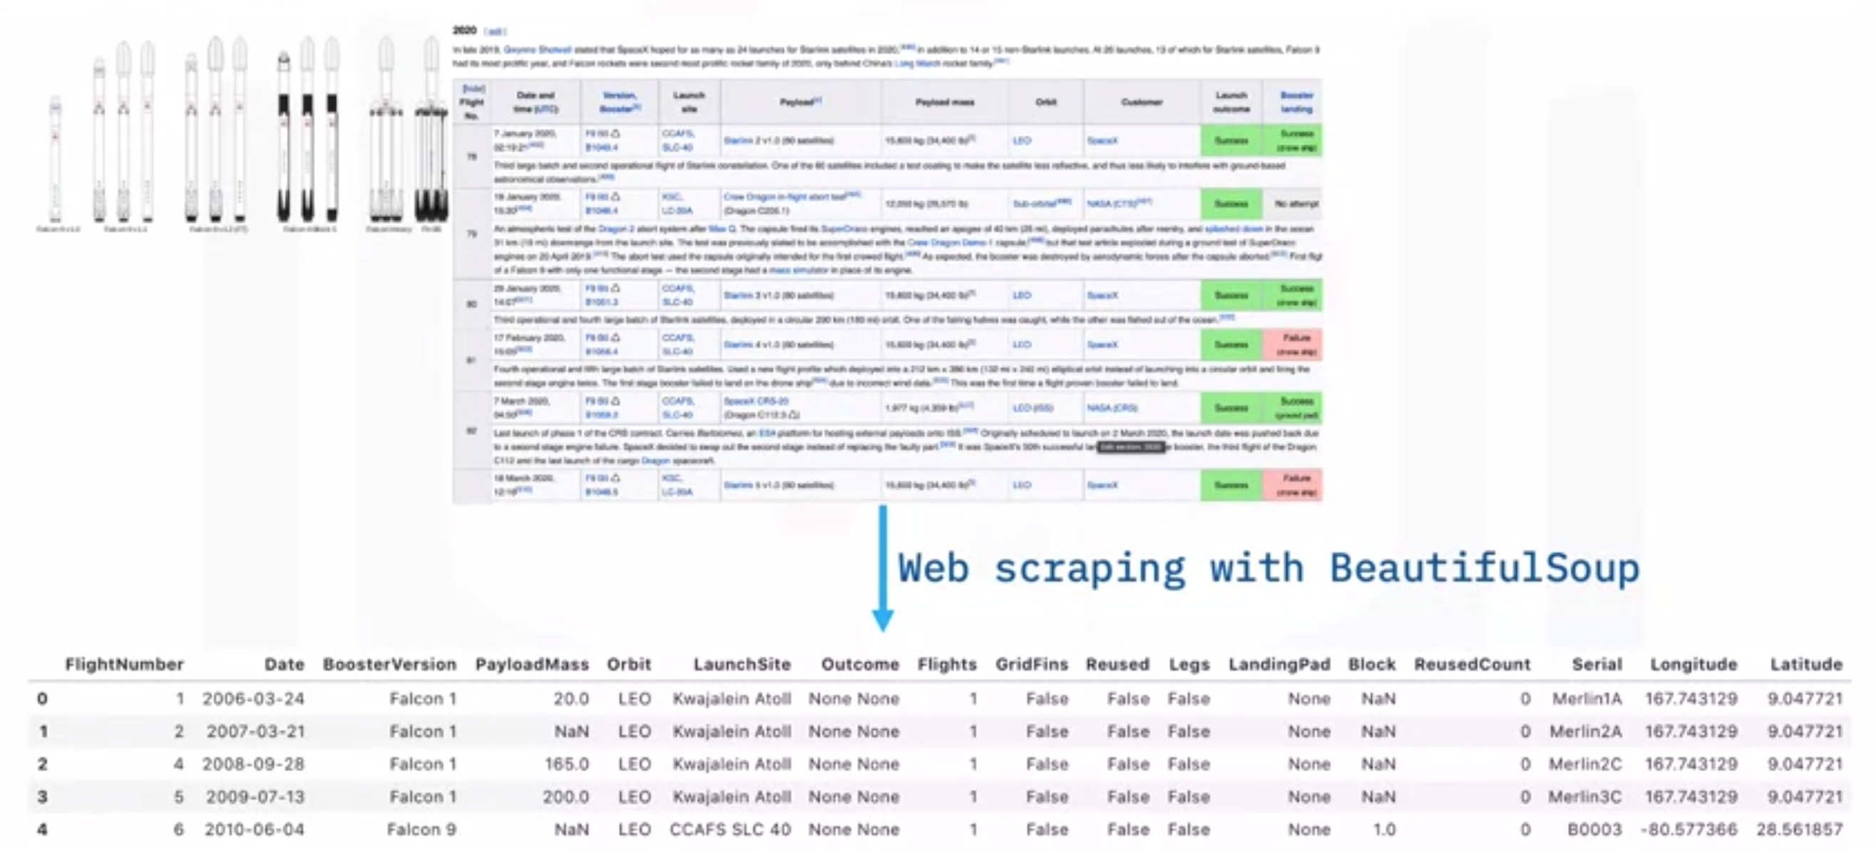
Data Collection - Scraping
The SpaceX launches can be found on Wikipedia
It can be downloaded then using beautiful soup can be extracted
https://github.com/OficialmenteJJC/Data-Science-Capstone/blob/main/jupyter-labs-webscraping.ipynb

Slide 10
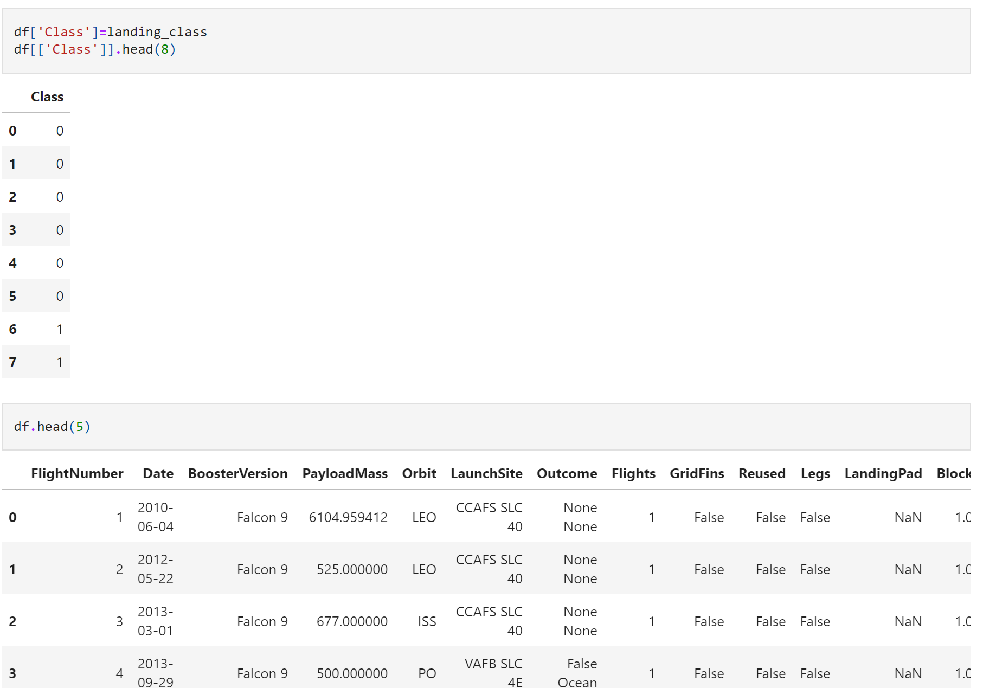
Data Wrangling
Describe how data were processed
Using EDA we summarized the data into categories then we created outcome tables
https://github.com/OficialmenteJJC/Data-Science-Capstone/blob/main/labs-jupyter-spacex-data_wrangling_jupyterlite.jupyterlite.ipynb

Slide 11
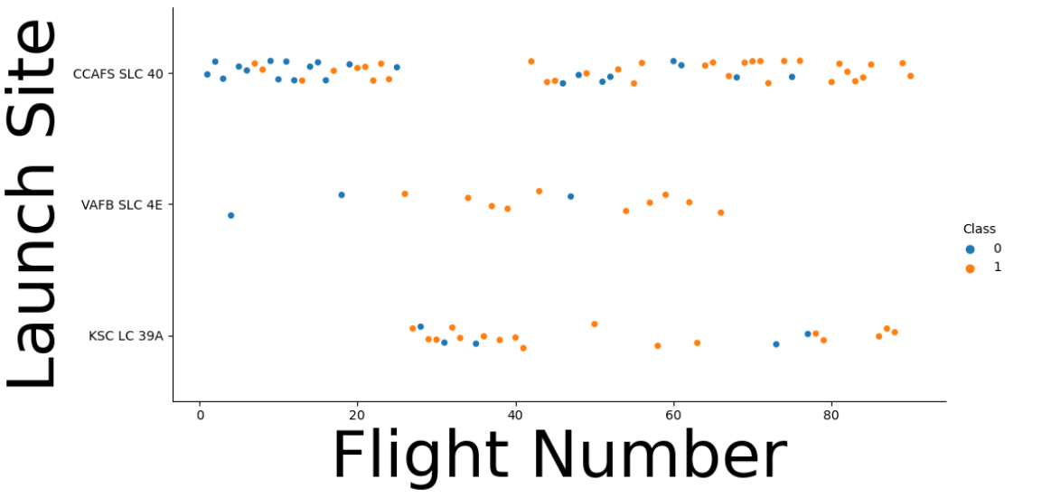
EDA with Data Visualization
To present the data scatterplots and bar graphs were used
https://github.com/OficialmenteJJC/Data-Science-Capstone/blob/main/jupyter-labs-eda-dataviz.ipynb.jupyterlite.ipynb

Slide 12
EDA with SQL
SQL queries performed:
Unique names of launch sites
Top 5 launch sites with names that start with ‘CCA’
Names and booster weighing between 400 and 600 kg that successfully landed
Names of the booster with max payloads
Failed landing outcomes of 2015
https://github.com/OficialmenteJJC/Data-Science-Capstone/blob/main/jupyter-labs-eda-sql-coursera_sqllite.ipynb

Slide 13
Build an Interactive Map with Folium
Summarize what map objects such as markers, circles, lines, etc. you created and added to a folium map
Explain why you added those objects
Markers showed the launch sites
The circles showed the areas around the coordinates we wanted
Lines are used to show how far each coordinate is from one another
https://github.com/OficialmenteJJC/Data-Science-Capstone/blob/main/vertopal.com_lab_jupyter_launch_site_location.jupyterlite.pdf

Slide 14
Build a Dashboard with Plotly Dash
Summarize what plots/graphs and interactions you have added to a dashboard
Explain why you added those plots and interactions
The plots/graphs were used to visualize the data by percentage of launches by site and payload range
The reason we did it is to show the best place to launch while using the amount of payload per mission
https://github.com/OficialmenteJJC/Data-Science-Capstone/blob/main/plotly

Slide 15
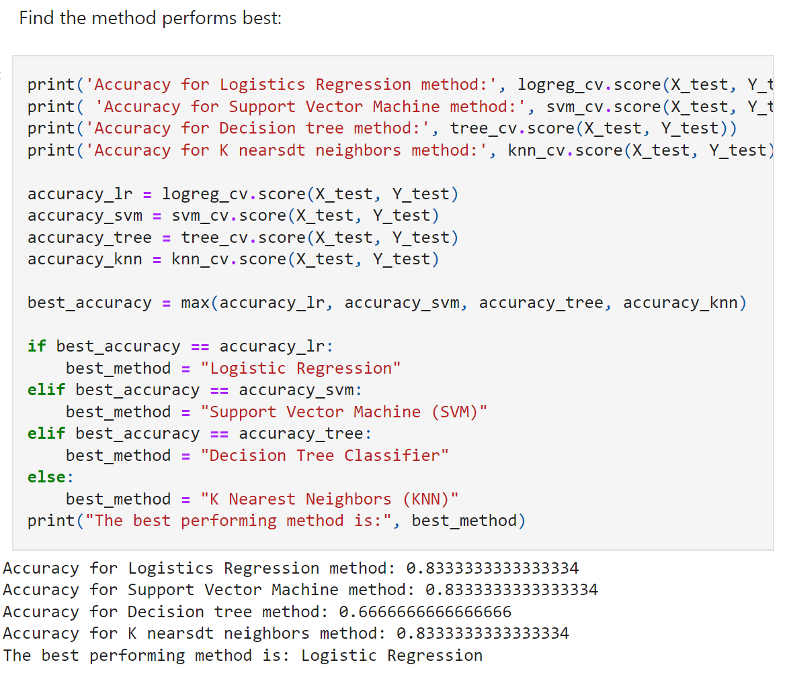
Predictive Analysis (Classification)
Summarize how you built, evaluated, improved, and found the best performing classification model
Using 4 classifications models logistic regression, support vector, decision tree, and k nearest neighbor the data was standardized and tested to produce the accuracy of success using each model.
https://github.com/OficialmenteJJC/Data-Science-Capstone/blob/main/SpaceX_Machine_Learning_Prediction_Part_5.jupyterlite.ipynb

Slide 16
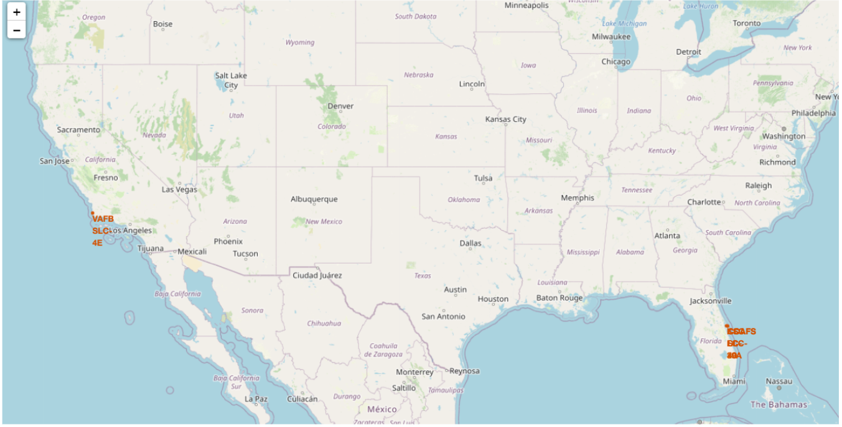
Results
Exploratory data analysis results
Interactive analytics demo in screenshots
Predictive analysis results
Using exploratory analysis we were able to find the locations of the sites used, how many, when they were launched, their payload sum, and the success rate of the landings
Using predictive analysis we were able to calculate the success rate for the missions using 4 different models to know for the next time they launch another Falcon 9 rocket, depending on many different categorial factors where should they launch.

Slide 17

Section 2

Slide 18
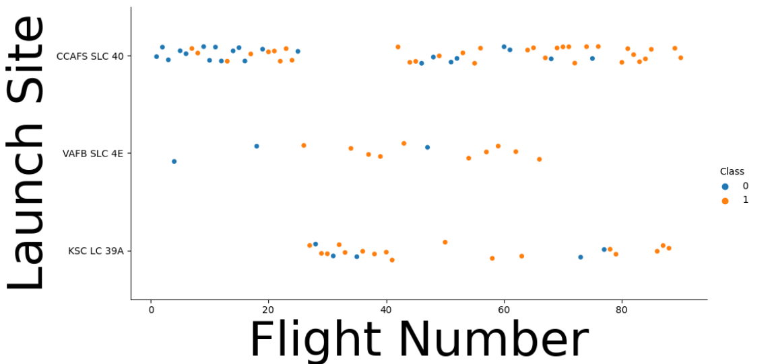
Flight Number vs. Launch Site
Looking at the data we can see that CCAF5 SLC 40 is the best place to launch because of the high success rate
We can also see the overall success rate increase over time

Slide 19
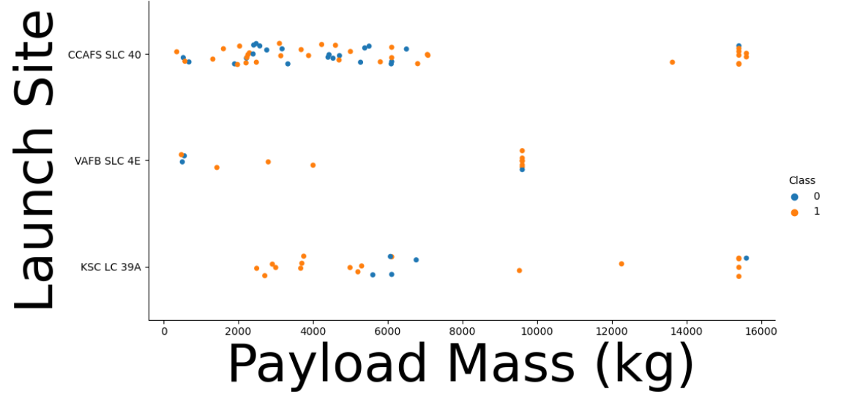
Payload vs. Launch Site
The data shows that payloads at 9000 kg and under have a high success rate overall

Slide 20
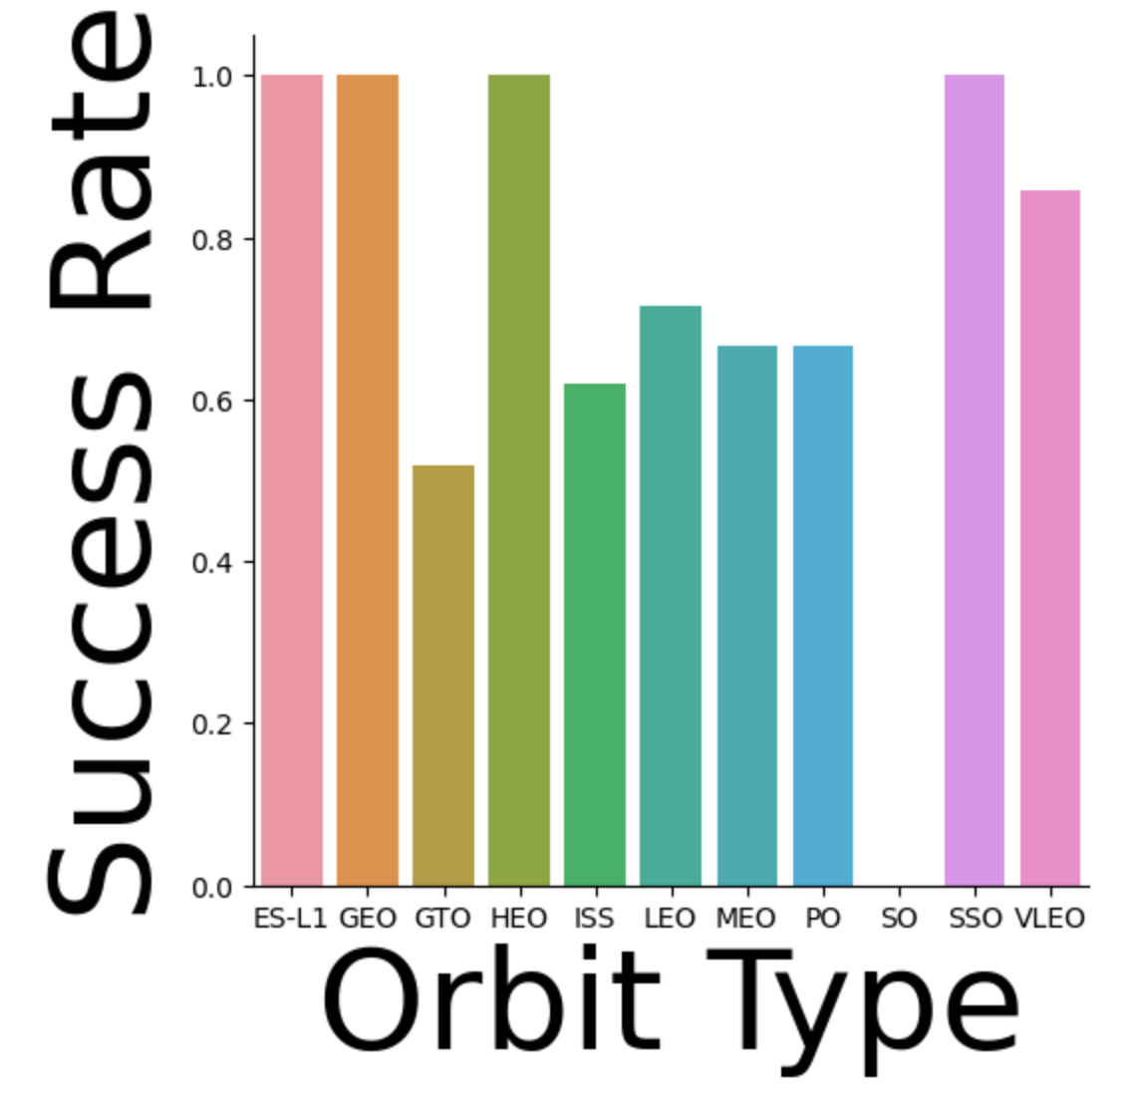
Success Rate vs. Orbit Type
Show a bar chart for the success rate of each orbit type
Success rate is the highest at
ES-L1
GEO
HIEO
SSO

Slide 21
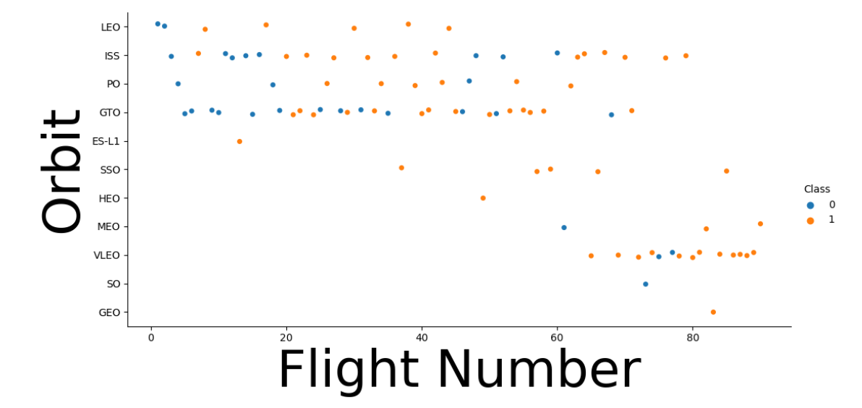
Flight Number vs. Orbit Type
Show a scatter point of Flight number vs. Orbit type
Overall you can see that success rate improved and that VLEO seems to be the new Orbit that SpaceX is going for

Slide 22
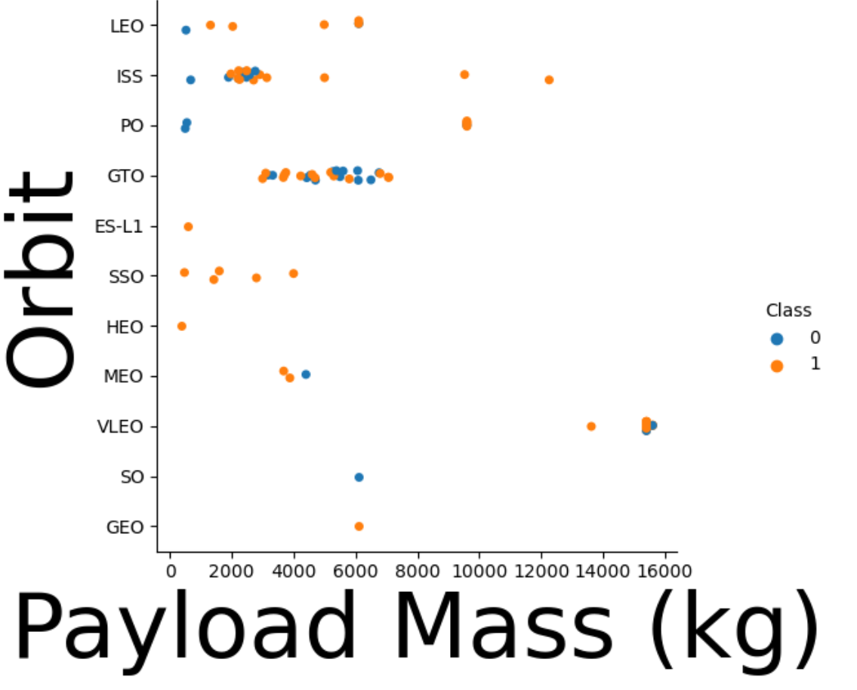
Payload vs. Orbit Type
Show a scatter point of payload vs. orbit type
Payload at GTO has no real affect and there is too little data on SO and GEO

Slide 23
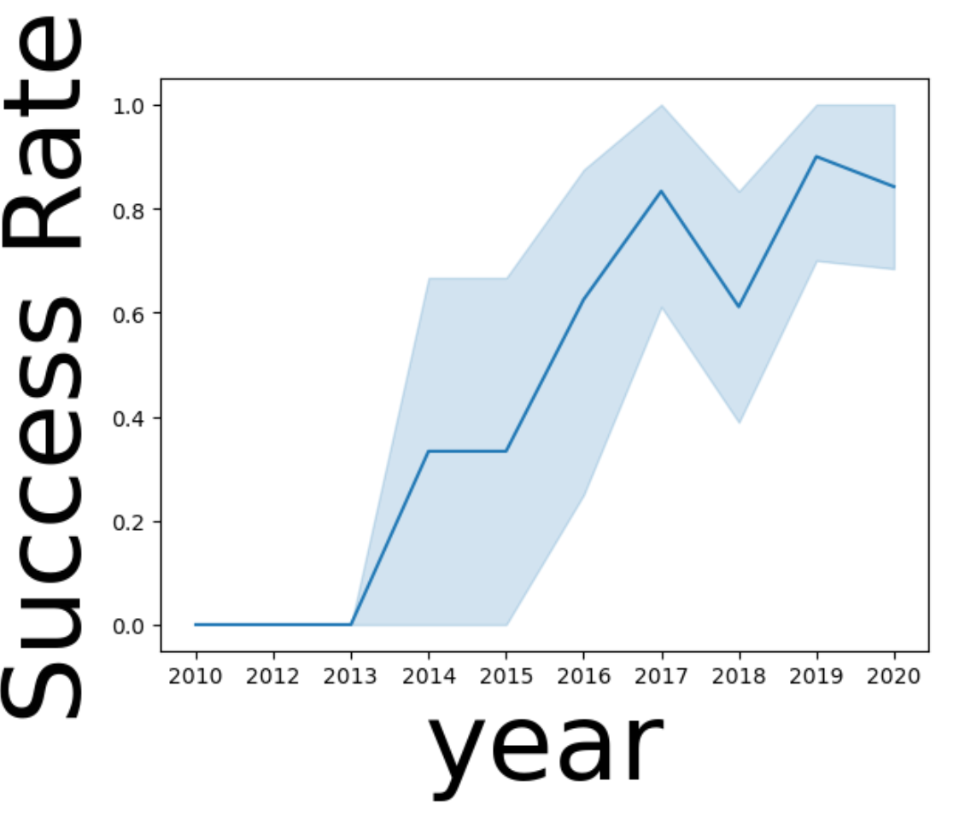
Launch Success Yearly Trend
Show a line chart of yearly average success rate
There seemed to be a continuous success rate until 2018 and halfway through 2019

Slide 24
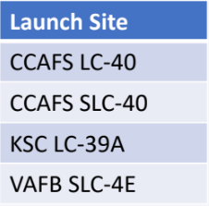
All Launch Site Names
Find the names of the unique launch sites
Using the “launch_site” value from the data set it shows you that there are 4 launch sites

Slide 25
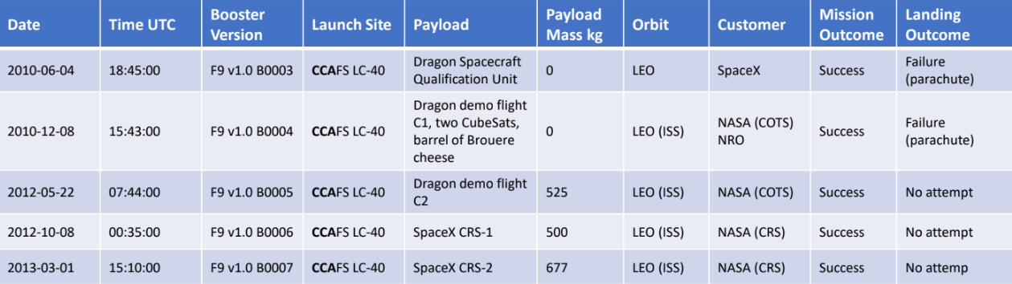
Launch Site Names Begin with 'CCA'
Find 5 records where launch sites begin with `CCA`

Slide 26
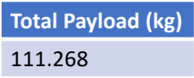
Total Payload Mass
Calculate the total payload carried by boosters from NASA
Total payload was calculated by summing all payloads with their code containing ‘CRS’ which is the code for NASA

Slide 27
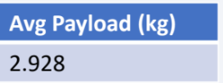
Average Payload Mass by F9 v1.1
Calculate the average payload mass carried by booster version F9 v1.1
After filtering the data by booster version the average payload mass obtained is 2,928 kg.

Slide 28
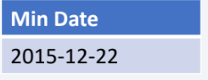
First Successful Ground Landing Date
Find the dates of the first successful landing outcome on ground pad
After filtering the data on ground pad the first successful landing was on 12-22-2015

Slide 29
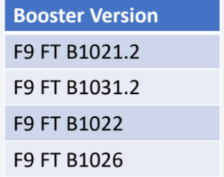
Successful Drone Ship Landing with Payload between 4000 and 6000
List the names of boosters which have successfully landed on drone ship and had payload mass greater than 4000 but less than 6000
After filtering for distinct booster versions the 4 booster versions used where these

Slide 30
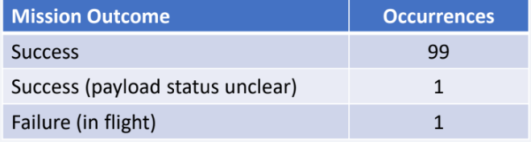
Total Number of Successful and Failure Mission Outcomes
Calculate the total number of successful and failure mission outcomes
After grouping mission outcomes and counting records produces this summary

Slide 31
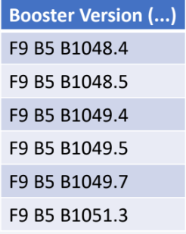
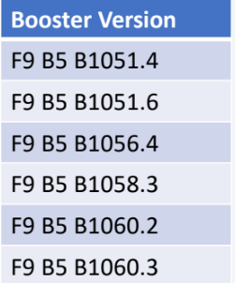
Boosters Carried Maximum Payload
List the names of the booster which have carried the maximum payload mass
These are the boosters that have had the maximum payload according to the data

Slide 32
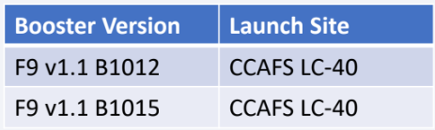
2015 Launch Records
List the failed landing_outcomes in drone ship, their booster versions, and launch site names for in year 2015
For failed landing outcomes in drone ships there were only 2

Slide 33
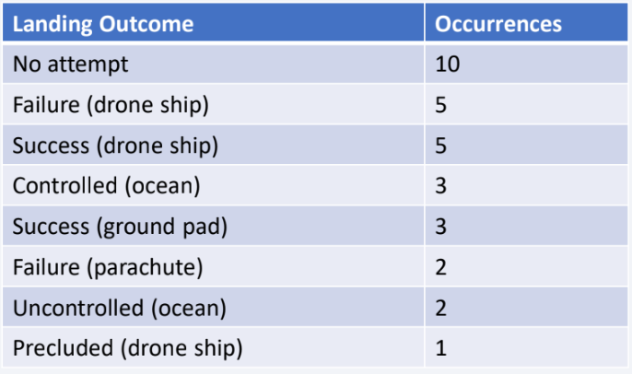
Rank Landing Outcomes Between 2010-06-04 and 2017-03-20
Rank the count of landing outcomes (such as Failure (drone ship) or Success (ground pad)) between the date 2010-06-04 and 2017-03-20, in descending order
Ranking: there were 5 Failure for drone ships which of the two datatypes we want to see its the current king for occurrences compared to the success of the ground pad at 3 times

Slide 34

Section 3

Slide 35
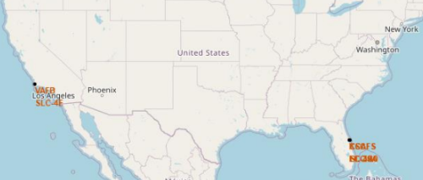
Launch sites
Launch sites tend to be near the sea rather than inland, most likely to transport the rockets by ship to the launch site since the payload is too high

Slide 36
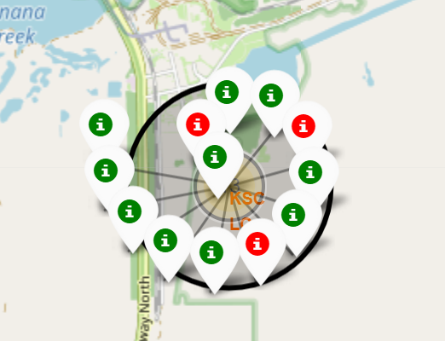
Launch Outcomes by Site
Green means success
Red means failure

Slide 37
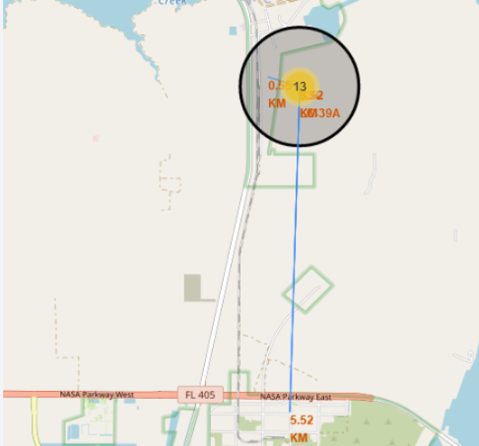
Logistics and Safety
KSC LC-39A is a goof place because its near the railroad but also far enough from any people

Slide 38

Section 4

Slide 39
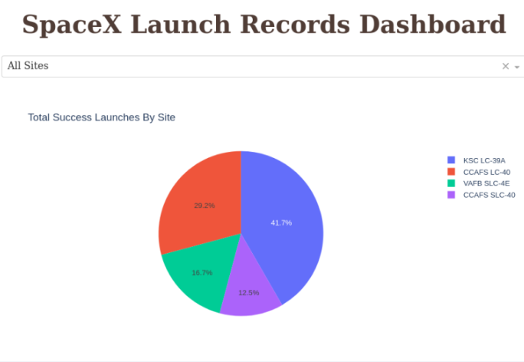
Site Launch success rate
KSC LC-39A seems to have the highest success rate

Slide 40
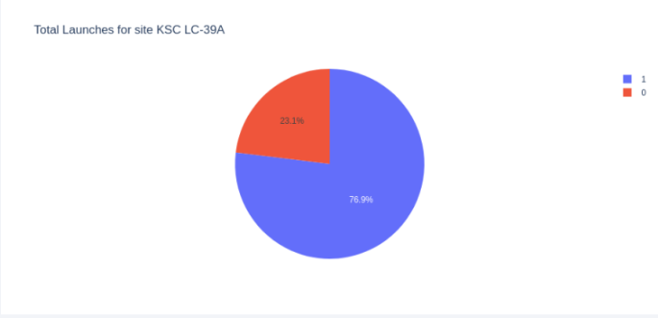
KSC LC-39A Success rate
76.9% of launches at KSC LC-39A were successful

Slide 41
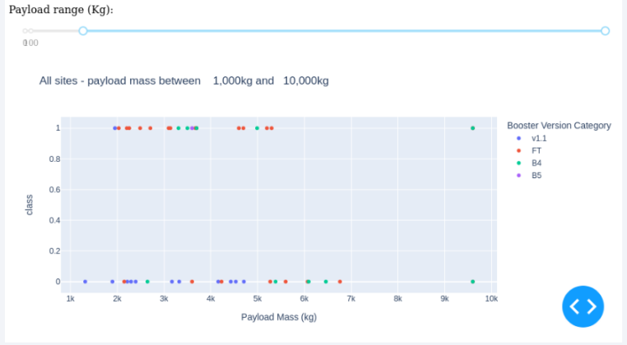
Payload vs Launch Outcome
Payloads under 6,000Kg have the highest success rate but after 7,000Kg there isn’t enough launches to predict the risk of the launch

Slide 42

Section 5

Slide 43
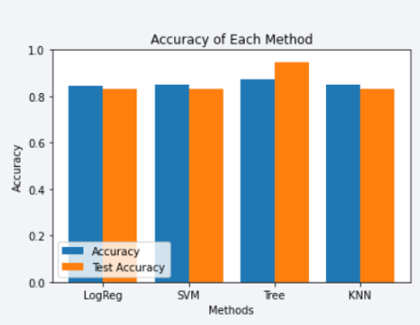
Classification Accuracy
According to the bar chart he accuracy of the highest model is the Tree classifier

Slide 44
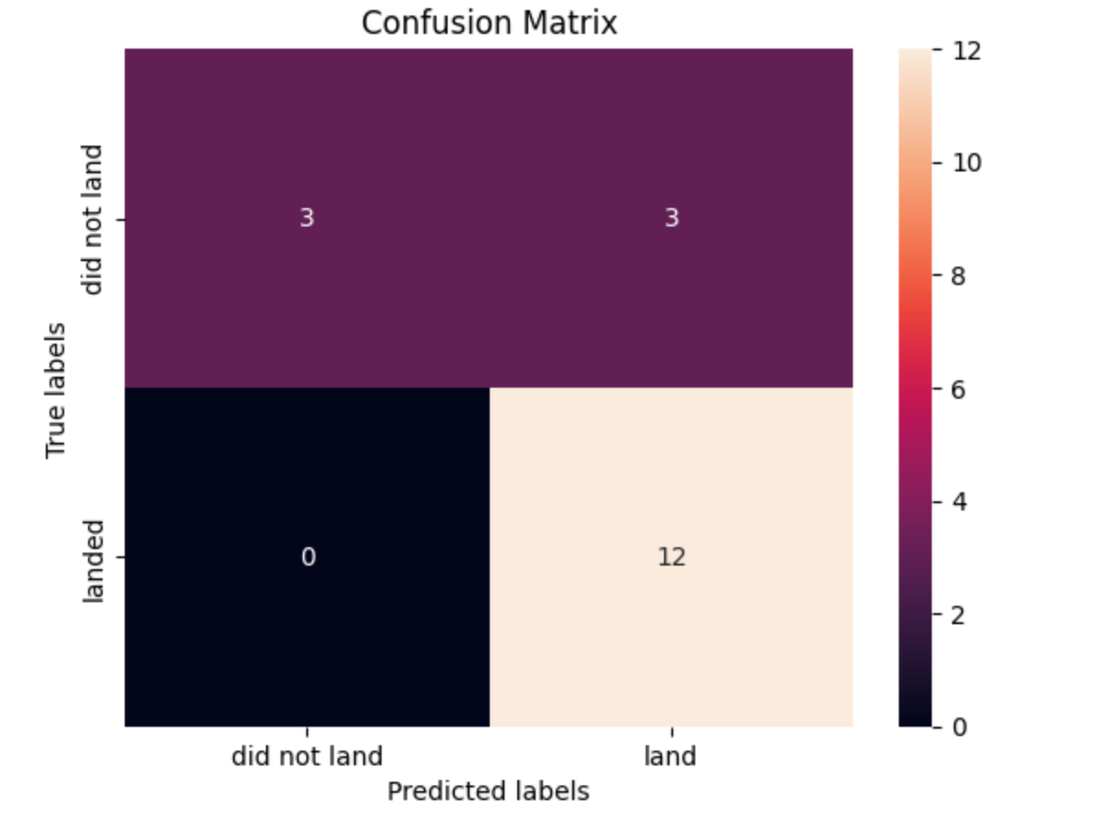
Confusion Matrix
However according to the confusion matrices the highest rate is the logistic model where 12 land

Slide 45
Conclusions
In conclusion:
The best launch site is KSC LC-39A
Success rate is the highest at or less than 6,000kg
To get the best predicted rate of success I would use the logistic model

Slide 46
Appendix
First few images were taken from the section explanation videos from the capstone final projects week 1 and 2
Folium didn’t show because it was turned into a PDF so GitHub was used for screenshots of the folium section

Slide 47


